Slide 1
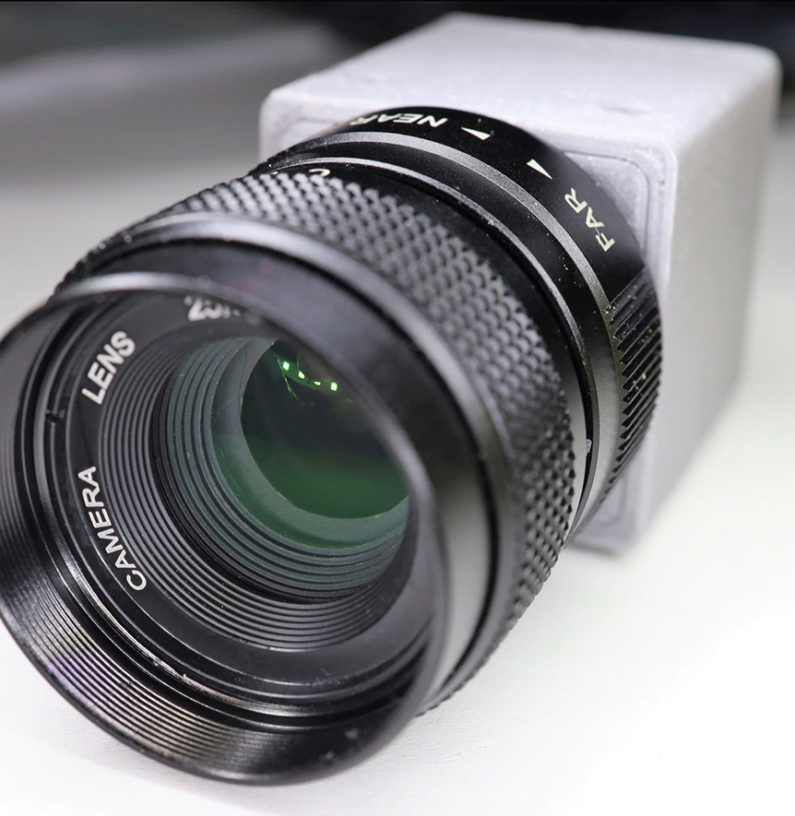
MARKET VIABILITY Camera Module Market
By WPI Team

Slide 2
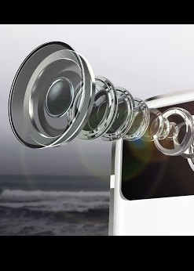
Agenda
01
02
03
04
05
06
Executive Summary
Business Case
Market Forecast and TAM
Market Drivers
Target Customer Accounts
Competitor Analysis
07
Vision for Competitive Advantage
08
Next Steps and Recommendation

Slide 3
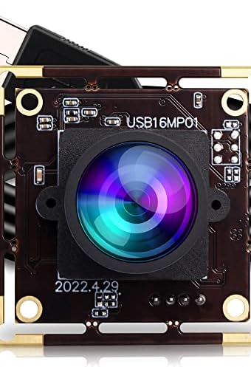
Executive Summary
Explored the Compact Camera Module (CCM) market with TAM and unit volume information.
Identified market drivers impacting CCM testing demand.
Analyzed prospective customers, current competitors and the product requirements .
Established paths to competitive advantage in CCM testing market.
Finally, would like to recommend Teradyne to enter the automotive testing market, R&D of sensor testing and look towards mergers or acquisitions of some small testing companies.

Slide 4
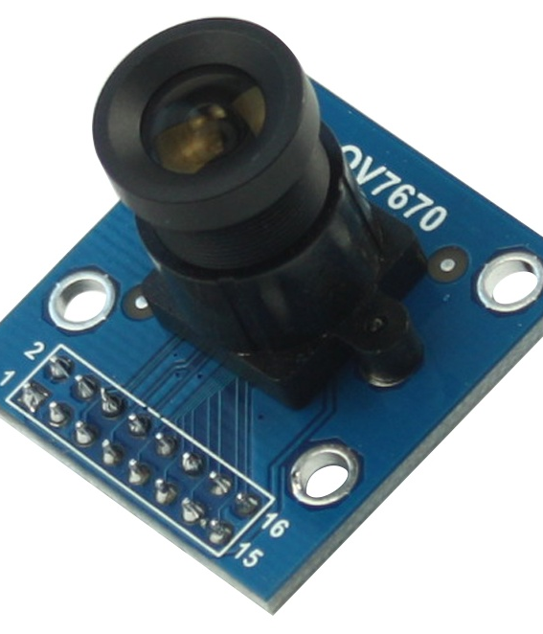
02
Business Case

Slide 5

Business Case
Our aim
Exploring the dynamics of the industry
Identifying Total Available Market (TAM)
Evaluating performance of current players
Analyzing target customer requirements
The goal
Determining whether entering the Camera Module Testing market is viable

Slide 6
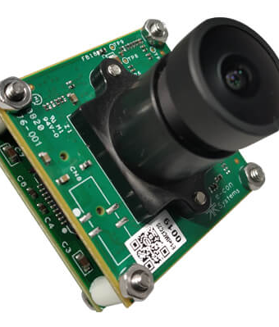
03
Market Forecast and TAM

Slide 7
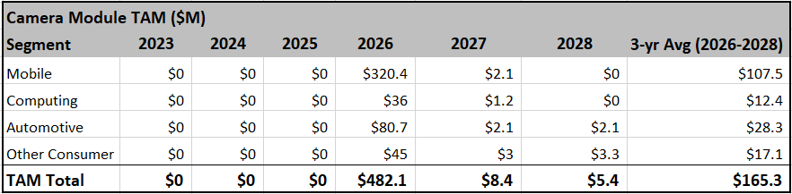
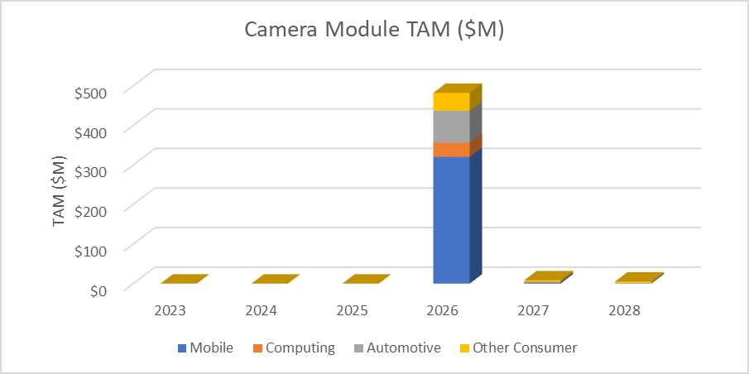
Market Forecast and TAM
2023 Yole Report unit volume projections and testing cost/time were used to create a TAM model of the four CCM segments from 2023-2028
2023-2025 TAM is $0M factoring in 3-year window of entry
$165.3M average TAM from 2026-2028
TAM is mostly driven by mobile CCMs - $320.4M TAM in 2026
Other segments garner respectable numbers however (Automotive market has $80.7M TAM in 2026)
Could be opportunities for new entrants to capitalize on improved CCM capabilities

Slide 8
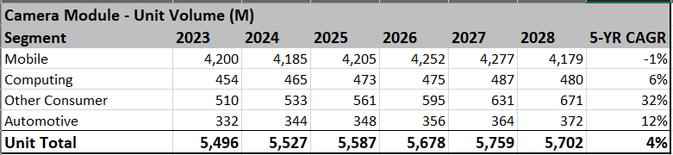
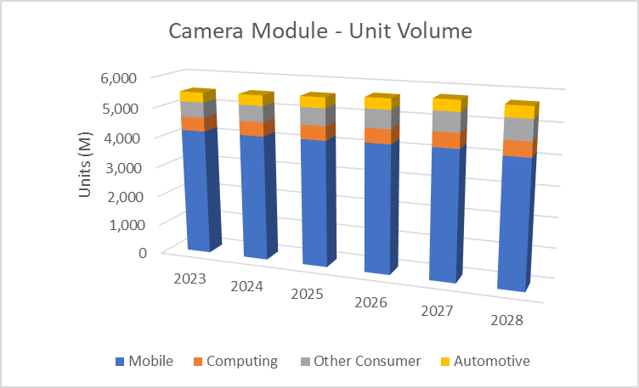
TAM Model Assumptions
Cost/Test Time Assumptions
System unit base cost - $300,000
Sites per unit – 6
Single site test time – 120 seconds
TAM models are based in part on incremental YoY unit changes
Graph uses 2026 as the start point of available TAM, since Teradyne has no offering prior
With 2026 as start point, 2027 and 2028 TAM are based on incremental unit changes
Assumes Teradyne will capture each market segment
Assumes cost and test times were constant for all segments
Assumes Teradyne will test 25% of CCMs – Automotive segment is 75%

Slide 9
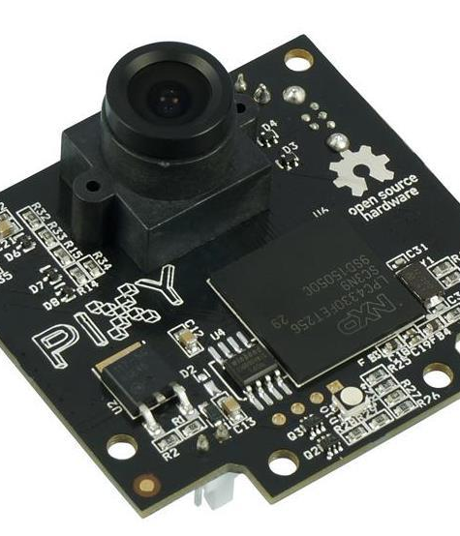
04
Market Drivers

Slide 10
MARKET DRIVERS
Technological Advancements
Smartphones
Laptops & PCs
Others
Automobile
Market Saturation
Economic Factors
Regulatory Environment
Consumer Preferences
Competitive Dynamics

Slide 11
MARKET DRIVERS
Top Factors in each industry
Smartphones
Laptops & PCs
Others
Automobile
Advancements in camera technology, Increased smartphone adoption & Market competition
Innovations and customizations, Integration of cameras & Remote work and learning trends
Rise of ADAS, Autonomous driving & Stringent quality standards
Consumer applications, Medical applications & Industrial applications

Slide 12
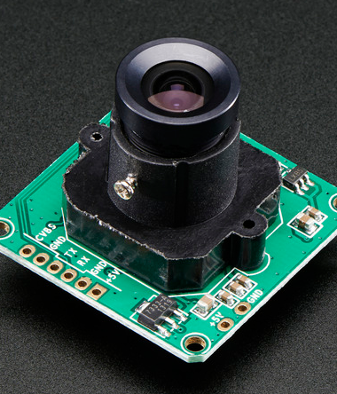
05
Target Customer Accounts

Slide 13
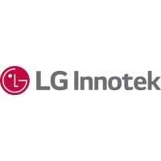



TARGET CUSTOMERS
Leading company in the industry with highest market share
Prominent player in the industry - Personally interviewed
In the Top 3 leading camera module market share
Leader in ADAS and Autonomous camera module line up

Slide 14
CUSTOMER ANALYSIS
LG INNOTEK
Rev Market Share: 25-35% in 2022 and 2023 (as per Yole report and Korea Business).
Products: Optical zoom camera, Imaging camera, Wide camera and many more.
Specialization: Mobile camera modules, Active alignment production.
Sales: 240M units sold in 2023 (mobile camera)
Recent innovation: High performance heating camera module.
Vision for 2024: To expand in Automotive and AI market.
Investment Strategy: $9B in Hai Phong facility and AOE Optronics.
SUNNY OPTICAL
Rev Market Share: 10% in 2022 (as per Yole report).
Products: Array camera, High resolution camera, Automotive camera and many more.
Specialization: Complete production line (mobile, automotive & AR/VR), Active alignment production.
Sales: 567M units sold in 2023 (mobile camera)
Recent innovation: In house testing equipment for in-line test process for steps & final assembly.
Vision for 2024: Increase competitiveness for automotive, XR and robot vision related business.

Slide 15
CUSTOMER ANALYSIS
Q-TECH
Rev Market Share: 6% in 2022 (as per Yole report).
Products: Ultra- thin camera modules, Optical Image Stabilization camera, Smartwatch camera and many more.
Specialization: Mobile camera modules and high-end products like fingerprint sensor.
Sales: 400K units sold in 2023 (mobile camera)
Vision for 2024: Increase camera module sales with Korean phone brands, Invest in periscope optical zoom and iOS optical products.
Investment Strategy: Increase partnerships with Automotive Industry manufacturers in China.
SAMSUNG ELECTRO-MECHANICS
Rev Market Share: 10% in 2022 (as per Yole report).
Products: Wide camera, Ultra-wide camera, Tele camera and many more.
Specialization: Complete camera module line up for Automotive ADAS and Autonomous driving.
Sales: 360M units sold in 2023 (automobile camera)
Vision for 2024: Mass production of automotive camera modules equipped with water repellent and heating functions.
Investment Strategy: Supplier of camera modules to Tesla's Model 3 sedan, Model S sedan, Model X SUV and Model Y

Slide 16
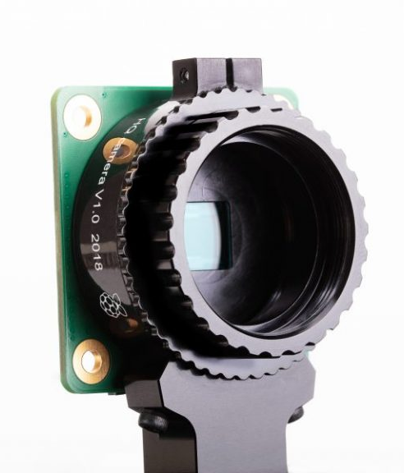
06
Competitor Analysis

Slide 17
COMPETITORS
TRIOPTICS
Leader in manufacturing optical test equipment
Creating standards for camera module testing
ASMPT AEi
De Facto leader in automotive camera active alignment market
TAM in 2021 - $60 million
DXOMARK
R&D company that provides high quality tested camera modules
It is a testing lab
Core Optics
Pioneer in high- value, specialized inspection equipment for CCM
Specialize in smartphone and automobile industry
Hioki
Leader in electrical manufacturing industry
High-speed testing equipment provider
All the above companies have been either acquired or separated, showing high volatility

Slide 18




COMPETITOR ANALYSIS
Subsidiary of Jenoptik AG
HQ: Wedel, Germany
Development and production of lenses and camera modules
Revenue in 2022: $1 billion (entire company)
10 products for camera module testing
AEi is now ASMPT AEi
HQ: Billerica, MA
Leading global supplier of HW & SW solutions
Revenue in 2022: $2.47 billion (entire company)
1 camera module test equipment which does 100% testing
DXOMARK separated from DxOLabs in 2017
HQ: Billancourt, France
Specializes in testing and optimizing digital imaging devices
Test and tune smartphone and standalone cameras as per requirement
Core Optics - subsidiary of the Coretec Group
HQ: North Carolina, US
Specializes in CCM technology for smartphones and automotive
Provide a comprehensive system for camera module production and testing

Slide 19
COMPETITOR ANALYSIS – Products Offered
End-of-line test system
Temperature testing
Position and Tilt of focus plane testing
Light requirement testing
Optical target projectors
Image quality testing
Measurement certification software
Post-Cure Test system for 100% testing - All ADAS camera testing
Image quality testing
Intrinsic Parameter Calibration
PCT FlexTest Software for customizing test configurations
Image Quality Testing
Texture preservation and noise evaluation
Color amplitude and intensity testing
A software to test image quality related to sensors, lens and ISP evaluation
CCM Development Kit
Focus Tester
Active Alignment
Full Auto solution
Final Tester – Electrical test, Image test, Defocusing AF function
HIOKI E.E Corporation
Electrical manufacturing industry providing electrical testing and measurement instruments
Products provided – Automatic testing equipment, data recording equipment, electronic measuring instruments, field measuring instruments and Camera module testing system

Slide 20
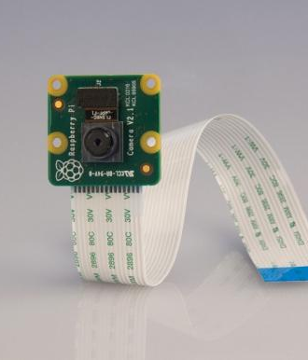
07
Vision for Competitive Advantage

Slide 21
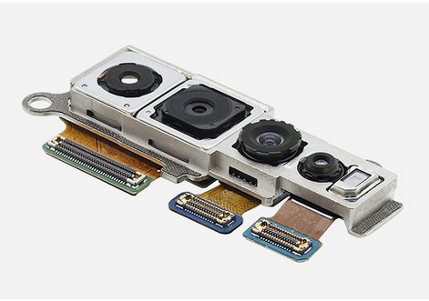
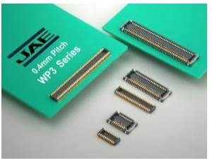
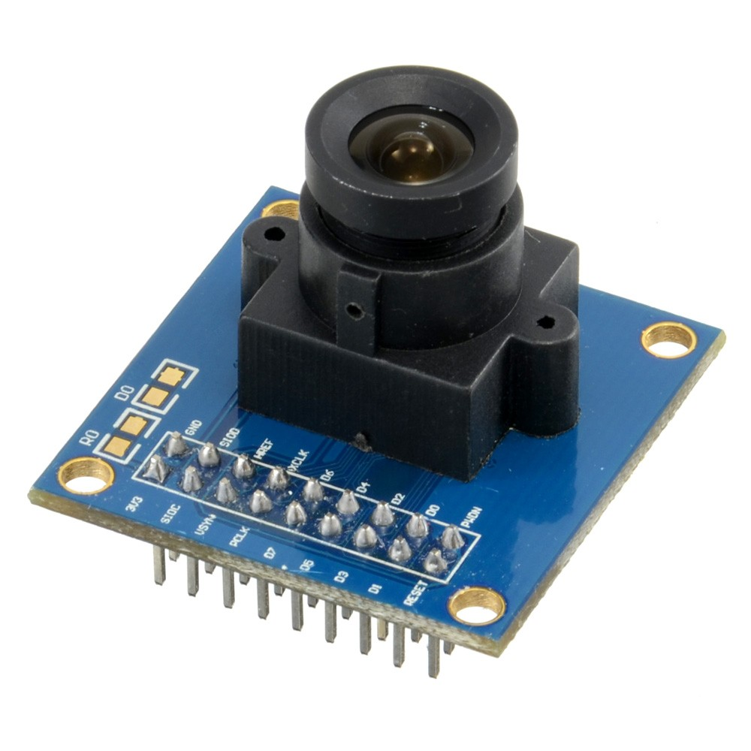
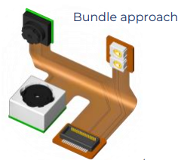
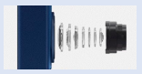
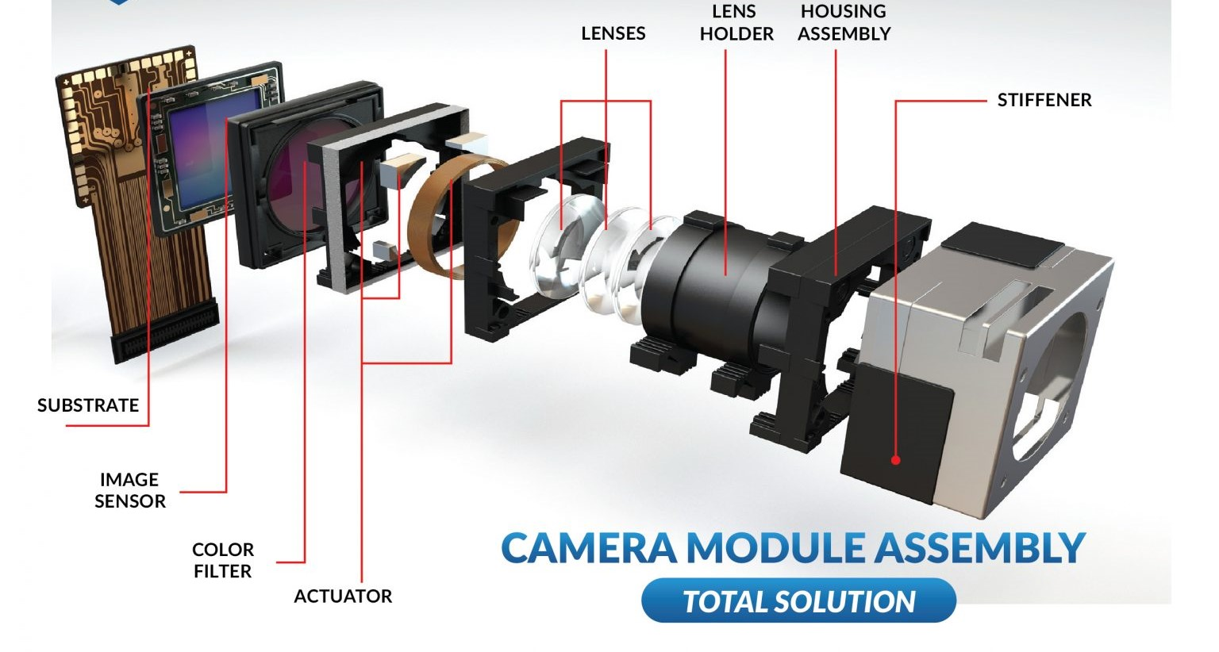
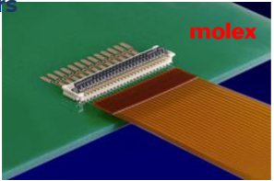
VISION FOR COMPETITIVE ADVANTAGE
Next-Generation Camera Module Testing​
Investment in ADAS & autonomous vehicle CCM​
Incorporation of 3D sensing, LiDAR, Active Alignment & Sensor Fusion​
Miniaturization in connections​
High number of lens elements
Single Flexible Circuit
Market Penetration Strategy with Entry Timeline
Single Market Penetration & Peak
Brand Image & Reputation
Low COT and Right Balance
Mobile – Low cost, mass production, high image quality
Automotive - Precision, Reliability, Dependability, & Relationships building

Slide 22
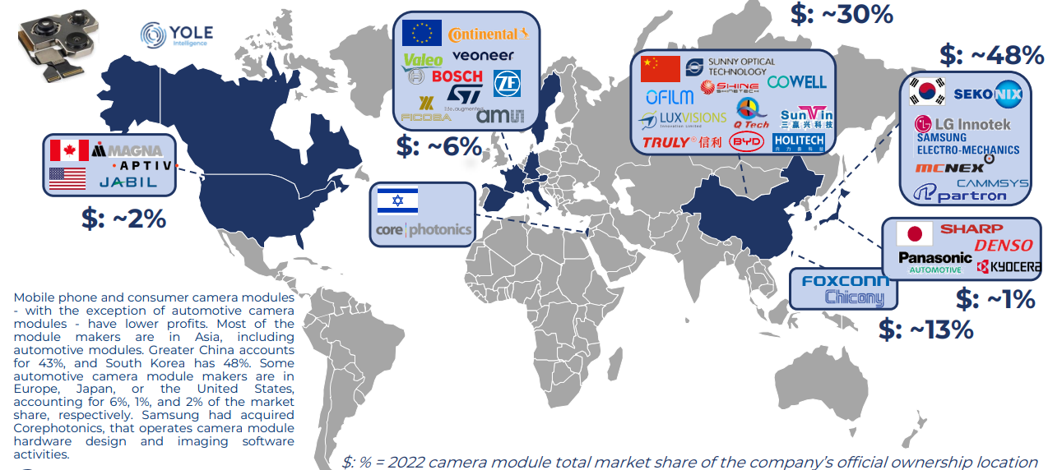
VISION FOR COMPETITIVE ADVANTAGE
MAP of CAMERA MODULE MANUFACTURING MARKET SHARES AND TOP CAMERA MODULE PLAYERS

Slide 23
VISION FOR COMPETITIVE ADVANTAGE
Identifying Right Customer
CCM Outsourced Testing
Strategic Partnerships
Collaboration, Partnerships – Unique Testing Requirement
Strategic Alliance, Acquisitions
Taking Advantage of the Automotive Sector
Customer Demand
Government Regulations
Regulatory Requirements
Industry Trends
Lower Profit Margin in Mobile CCM
Manufacturers
Testers

Slide 24
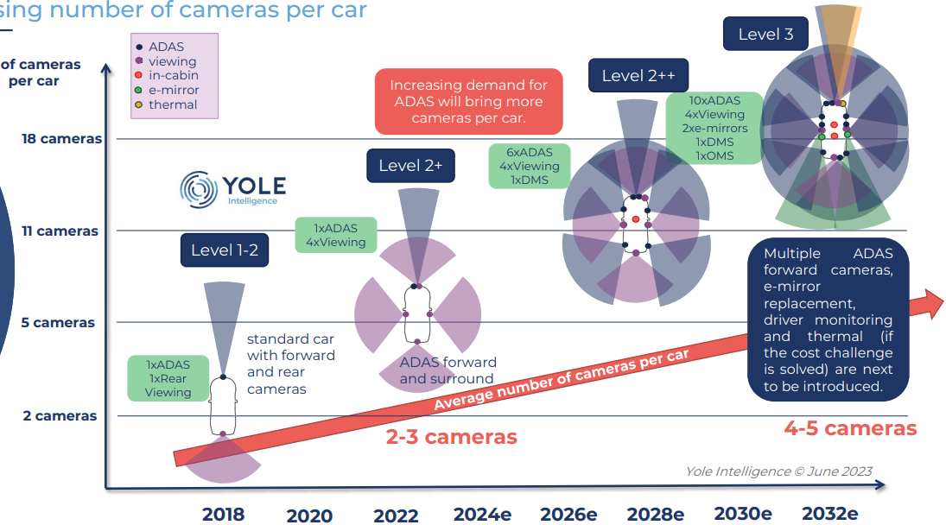
VISION FOR COMPETITIVE ADVANTAGE
Increasing number of cameras per car
Tesla Model Y – 9 CCM
Source: Yole Report June 2023
Evolution of Number of Camera Modules

Slide 25
CoT MODEL
Ser | Resolution | Price per Mp | Total Price | Components Cost Breakdown
 |  |  |  | Profit CCM | Assembly CCM | Substrate & others | Lens | Actuator (AF & OIS) | Image sensor
1. | 1-3Mp | ¢ 64 | $1.2 | ¢ 15 | ¢ 06 | ¢ 26 | ¢ 26 | ¢ 0 | ¢ 55
2. | 5-8Mp | ¢ 38 | $2.5 | ¢ 29 | ¢ 15 | ¢ .46 | ¢ 46 | ¢ 0 | $1.07
3. | 10-13Mp | ¢ 52 | $6 | ¢ 77 | ¢ 36 | ¢ 95 | $1.01 | ¢ 48 | $2.38
4. | 16-30Mp | ¢ 30 | $7 | ¢ 90 | ¢ 48 | $0.90 | $1.03 | ¢ 62 | $2.96
5. | 32-48Mp | ¢ 31 | $12.5 | $1.60 | $0.86 | $0.98 | $1.72 | $1.11 | $6.02
6. | 50Mp+ | ¢ 43 | $21.8 | $3.03 | $1.52 | $1.30 | $2.92 | $2.06 | $10.83
Samsung S24 Ultra |  | Profit CCM | Assembly CCM | Substrate & Others | Lens | Actuator | Image Sensors
200 MP (wide) = $86 |  | $ 12.12 | $ 6.08 | $ 5.20 | $ 11.68 | $ 8.24 | $ 43.32
10 MP (telephoto) = $5.20 |  | ¢ 0.77 | ¢ 0.36 | ¢ 0.95 | $ 1.01 | ¢ 0.48 | $ 2.38
50 MP (Periscopic Telephoto) = $21.5 |  | $ 3.03 | $ 1.52 | $ 1.30 | $ 2.92 | $ 2.06 | $ 10.83
12 MP (ultrawide) = $6.24 |  | ¢ 0.77 | ¢ 0.36 | ¢ 0.95 | $ 1.01 | ¢ 0.48 | $ 2.38
12 MP (selfie) = $6.24 |  | ¢ 0.77 | ¢ 0.36 | ¢ 0.95 | $ 1.01 | ¢ 0.48 | $ 2.38
 |  | $ 17.46 | $ 8.68 | $ 9.35 | $ 17.63 | $ 11.74 | $ 61.29
Total cost = $125.28, Number of Sites, Test Time, Number of Tests

Slide 26
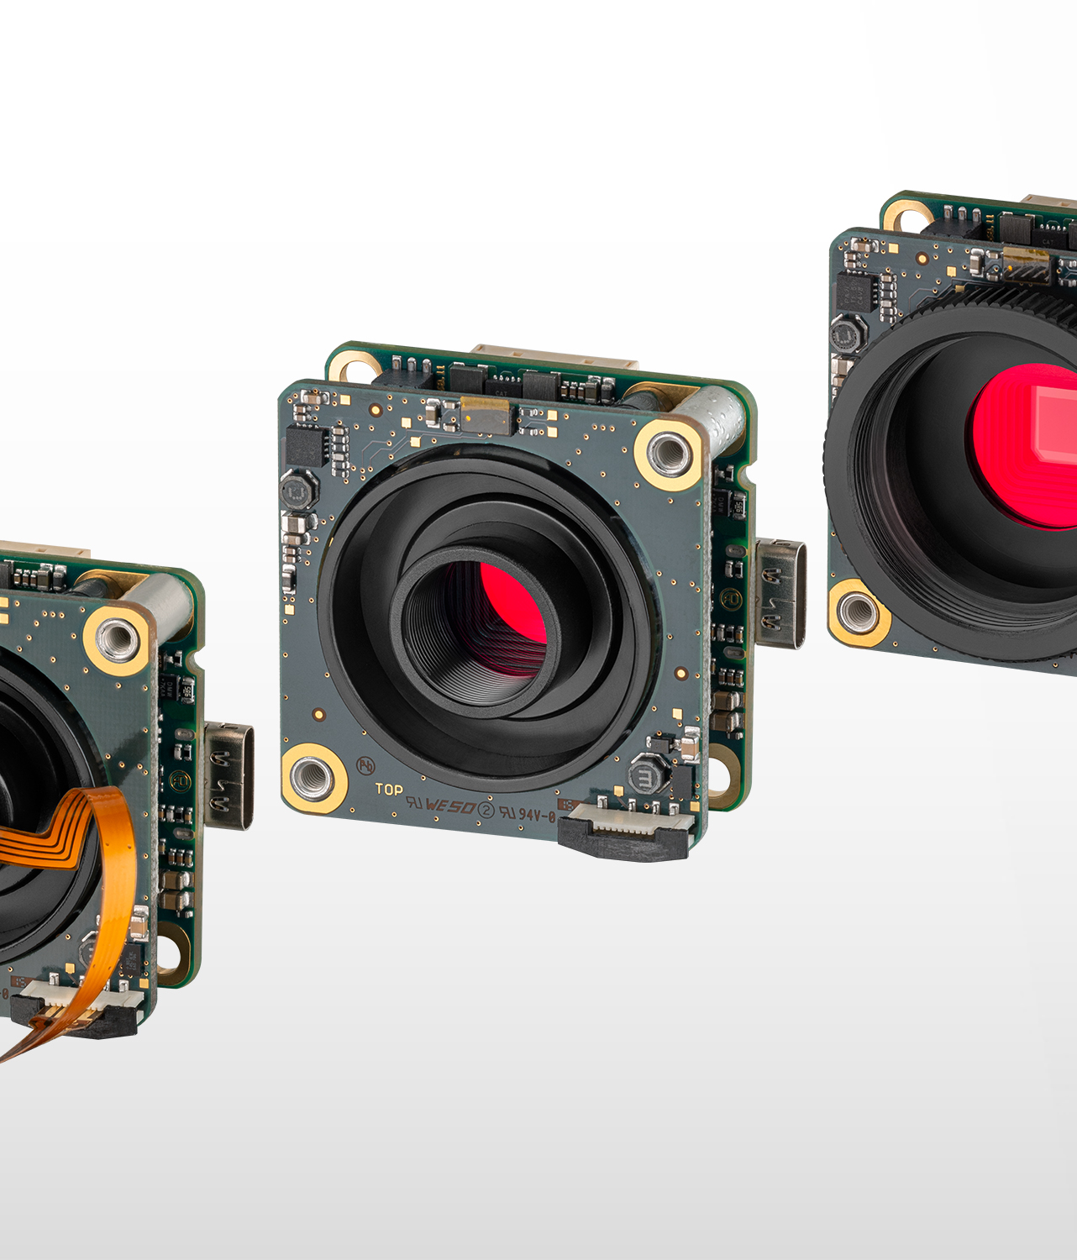
08
Next Steps and Recommendations

Slide 27
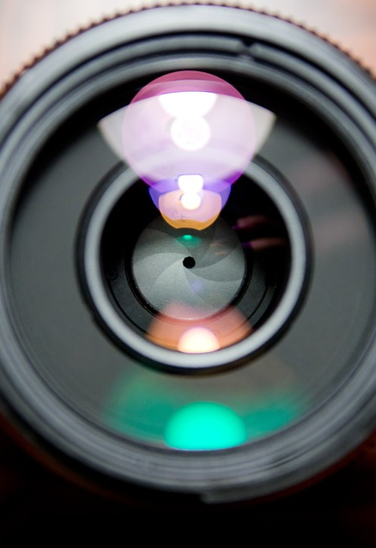
LIMITATIONS AND NEXT STEPS
01
02
03
04
05
06
Limited data for accurate predictions
CCM testing volume estimation challenge
Regulatory standards compliance
Cost of Test model requirements
Profitability and ROI projections
Capital requirements

Slide 28

FINAL RECOMMENDATIONS
Strategically enter the Automotive camera module testing market by 2028.
Prioritize investment in R&D of sensor testing technology, due to its rapid growth in the future.
Consider mergers or acquisitions of small and new camera testing companies to help cover a wider range of testing services.

Slide 29
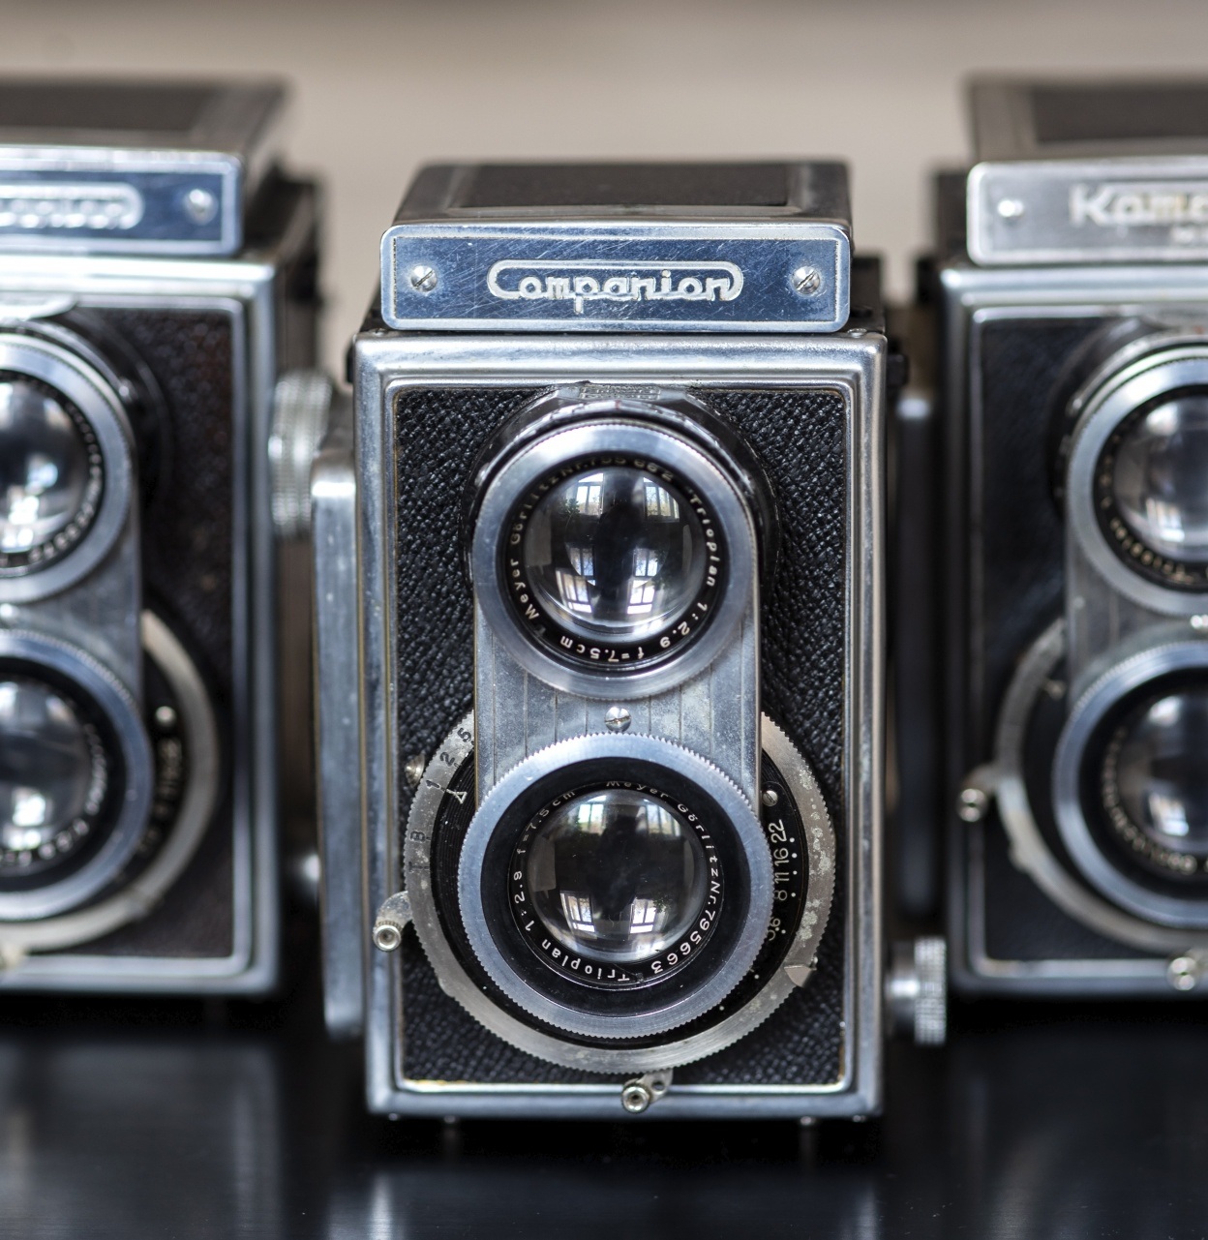
Thank You
We would like to open the floor for questions
WPI TEAM

